Slide 1

Correlation of National level factors with Covid-19.
Eliot Cleveland
Gina Freed
Marc Leslie

Slide 2

Motivation and Overall Summary
What’s going on in the data?
We thought richer and more developed countries should fair better during the pandemic, but…
We looked at various factors we believed might be at play
GDP, Population, Population Density
Corruption index, Human Decency index
Ultimately we believe that there may be information bias – higher GDP countries had better testing and reporting
Some evidence to support GDP and Population Density
Picture credit:
https://www.vanityfair.com/news/2020/03/anthony-fauci-on-dealing-with-coronavirus-and-trump

Slide 3
Dataset

Slide 4
Data clean up
It was a big dataset, so we removed the extra data and NaNs
We merged with the transparency data, lost a few countries
Then got to work exploring the dataset

Slide 5
Data exploration

Slide 6
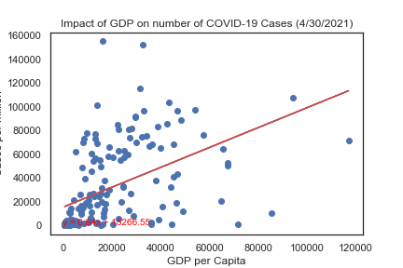
Regression - GDP

Slide 7
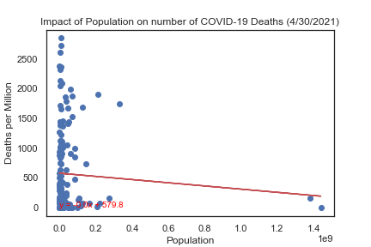
Regression – Population

Slide 8
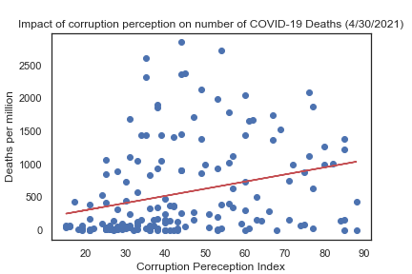
Regression – Transparency

Slide 9
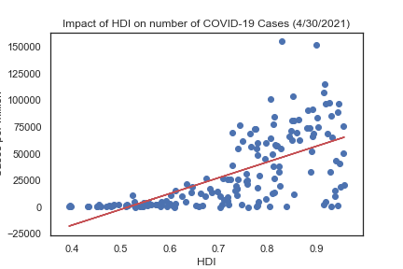
Regression – HDI (More Correlated)

Slide 10
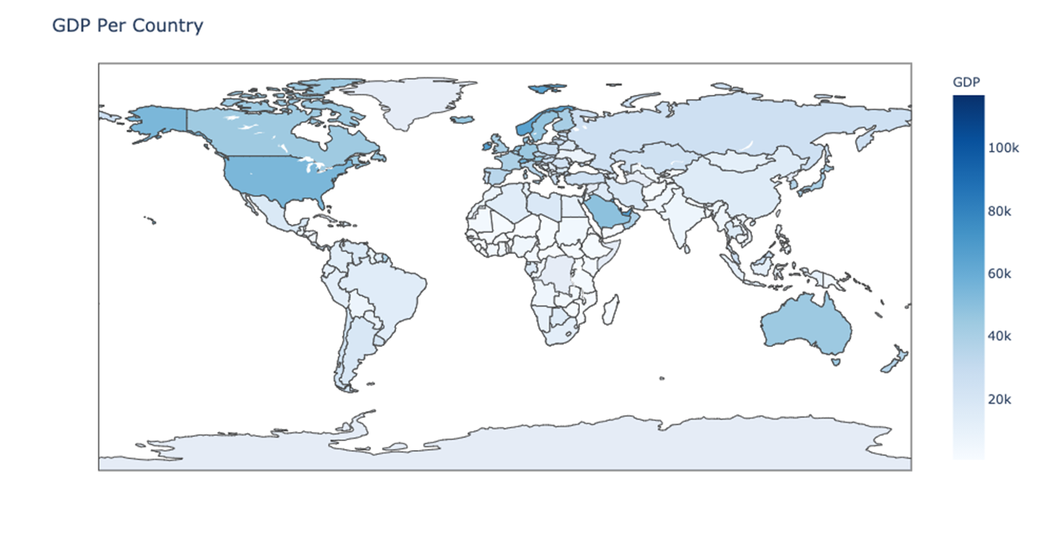
Maps – Fun to look at, difficult to interpret

Slide 11
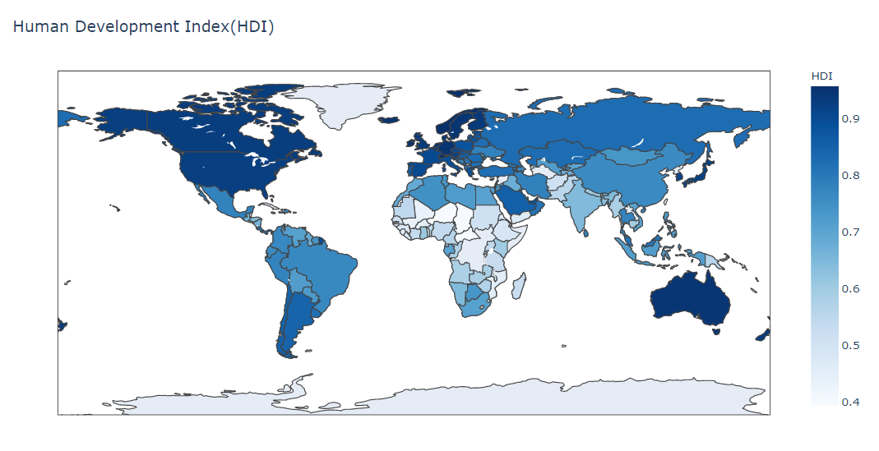
Maps – GDP & HDI were most correlated

Slide 12
Population

Slide 13
Analysis

Slide 14
Challenges
Uniformity in reporting was lacking

Slide 15
Suggestions Future Research
Likely an information bias
Need data for percent positivity or tests per capita by county
Examples of this data fell woefully short but potentially could be piecemealed together
Look at more granular data
Lots of noise at the national level
Population/population density not well understood at national level
Need more vaccination data

Slide 16
Works Cited
Marsja, Erik. “Four Ways to Conduct One-Way ANOVA with Python.” Erik Marsja, 19 Nov. 2020,
“2020 - CPI.” Transparency.org, www.transparency.org/en/cpi/2020.
“Schengen Countries: Visa Information for Schengen Area.” ETIAS Visa Waiver for Europe, www.etiasvisa.com/schengen-visa/countries.
Regions of Western Europe, saylordotorg.github.io/text_world-regional-geography-people-places-and-globalization/s05-04-regions-of-western-europe.html.
“Boxplot : Outliers Labels Python.” Edited by Andrea Blengino 4, Stack Overflow, 7 Nov. 2016, 16:41, stackoverflow.com/questions/40470175/boxplot-outliers-labels-python.
Mooney, Paul. “Latitude and Longitude for Every Country and State.” Kaggle, 13 Mar. 2020, www.kaggle.com/paultimothymooney/latitude-and-longitude-for-every-country-and-state.

